Slide 1
Probabilistic ML
Based on Dr. Piyush Rai’s slides from ML course at IITK
And
“Introduction to Statistical Learning” Book 2nd edition, Chapter 4
https://www.statlearning.com/

Slide 2
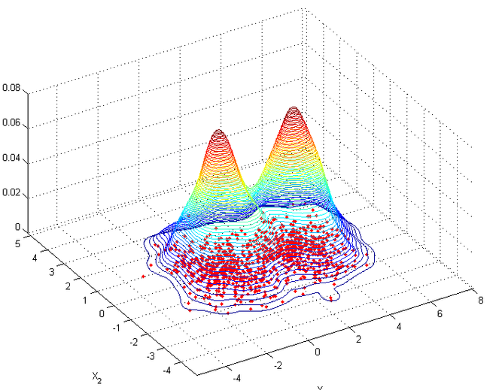
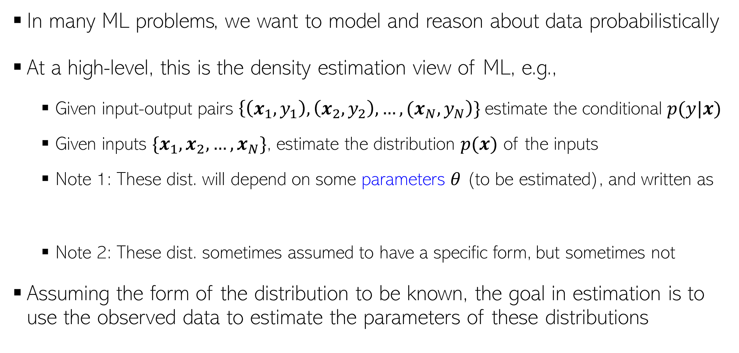
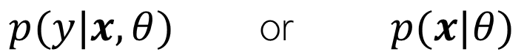
Probabilistic ML: Some Motivation
In many ML problems, we want to model and reason about data probabilistically
At a high-level, this is the density estimation view of ML, e.g.,
Given input-output pairs $\left\{\left(x_{1},y_{1}\right),\left(x_{2},y_{2}\right),…,{(x}_{N},y_{N}\right)\}$estimate the conditional $p(y|x)$
Given inputs $\{x_{1},x_{2},…,x_{N}\}$, estimate the distribution $p(x)$ of the inputs
Note 1: These dist. will depend on some parameters $θ$ (to be estimated), and written as
Note 2: These dist. sometimes assumed to have a specific form, but sometimes not
Assuming the form of the distribution to be known, the goal in estimation is to use the observed data to estimate the parameters of these distributions
p(y=green|x)
p(y=red|x)
$$p(y|x,θ) \text{or} p(x|θ)$$

Slide 3

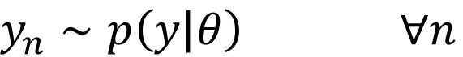
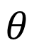
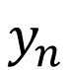
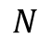
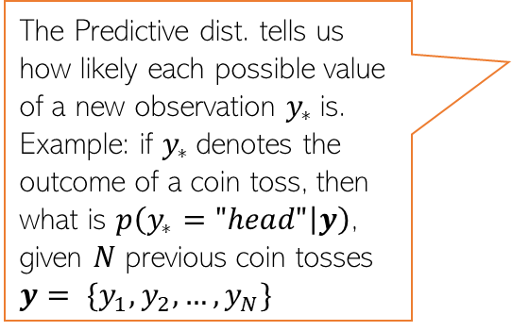
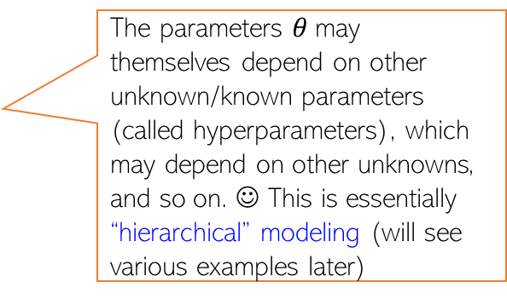
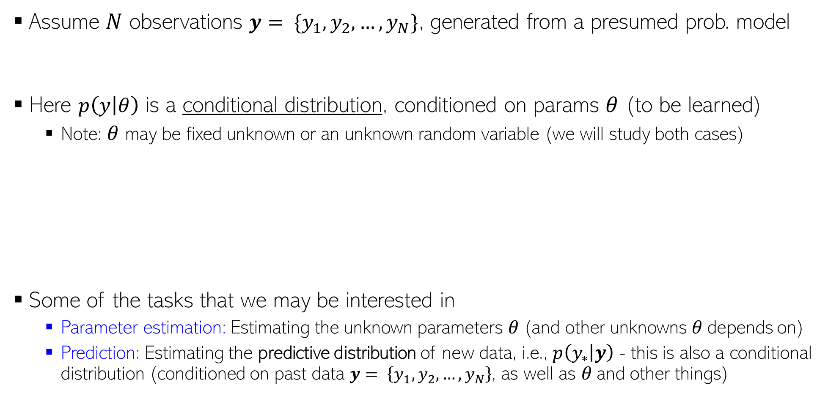
Probabilistic Modeling: The Basic Idea
Assume $N$ observations $y= \{y_{1},y_{2},…,y_{N}\}$, generated from a presumed prob. model
Here $p\left(y | θ\right)$ is a conditional distribution, conditioned on params $θ$ (to be learned)
Note: $θ$ may be fixed unknown or an unknown random variable (we will study both cases)
Some of the tasks that we may be interested in
Parameter estimation: Estimating the unknown parameters $θ$(and other unknowns $θ$depends on)
Prediction: Estimating the predictive distribution of new data, i.e., $p\left(y_{∗} | y\right)$ - this is also a conditional distribution (conditioned on past data $y= \left\{y_{1},y_{2},…,y_{N}\right\}$, as well as $θ$and other things)
$y_{n}∼p\left(y | θ\right) ∀n$
$$\text{(}\text{assumed} \text{independently}\text{ \& }\text{identically} \text{distributed}\text{ (}\text{i}\text{.}\text{i}\text{.}\text{d}\text{.)}\text{)}$$
The parameters $θ$may themselves depend on other unknown/known parameters (called hyperparameters), which may depend on other unknowns, and so on. ☺ This is essentially “hierarchical” modeling (will see various examples later)
$$θ$$
Such diagrams are usually called the
“plate notation”
The Predictive dist. tells us how likely each possible value of a new observation $y_{∗}$is. Example: if $y_{∗}$denotes the outcome of a coin toss, then what is $p\left(y_{∗}="head" | y\right)$, given $N$ previous coin tosses
$y= \{y_{1},y_{2},…,y_{N}\}$
$$y_{n}$$
$$N$$

Slide 4

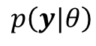
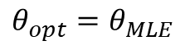
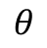
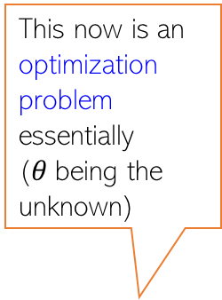
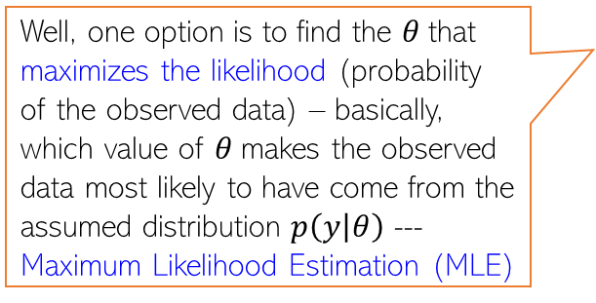
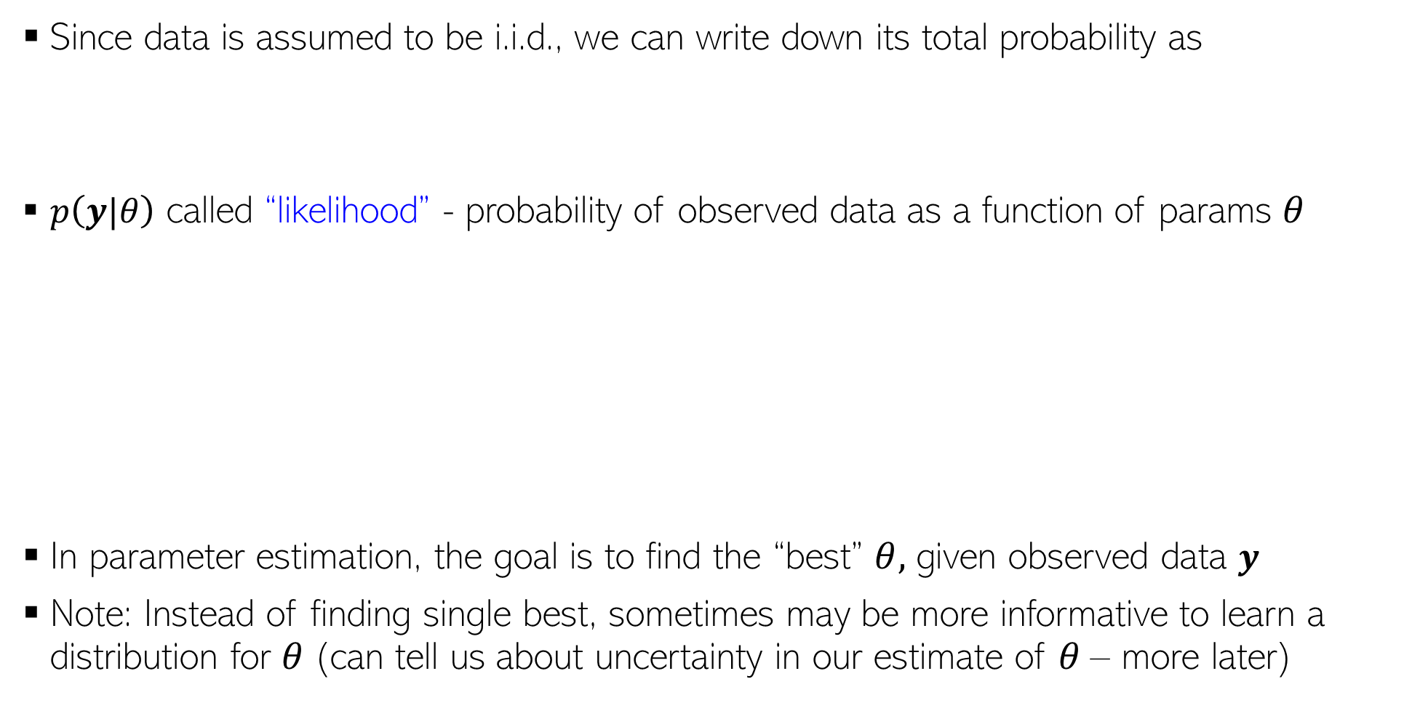

Parameter Estimation in Probabilistic Models
This now is an optimization problem essentially ($θ$being the unknown)
Since data is assumed to be i.i.d., we can write down its total probability as
$p\left(y|θ\right)$ called “likelihood” - probability of observed data as a function of params $θ$
In parameter estimation, the goal is to find the “best” $θ,$ given observed data $y$
Note: Instead of finding single best, sometimes may be more informative to learn a distribution for $θ$(can tell us about uncertainty in our estimate of $θ$– more later)
$p\left(y|θ\right)=p\left(y_{1},y_{2},…,y_{N} | θ\right)$ $= \prod_{n=1}^{N}{p(y_{n}|θ)}$
$$p\left(y|θ\right)$$
Well, one option is to find the $θ$that maximizes the likelihood (probability of the observed data) – basically, which value of $θ$makes the observed data most likely to have come from the assumed distribution $p\left(y | θ\right)$ --- Maximum Likelihood Estimation (MLE)
How do I find the best $θ$ ?
$$θ_{opt}=θ_{MLE}$$
$$θ$$

Slide 5
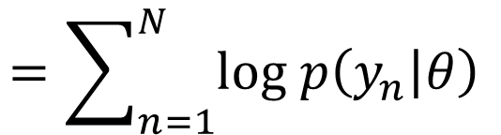
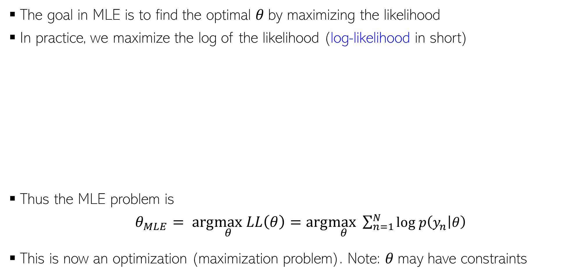
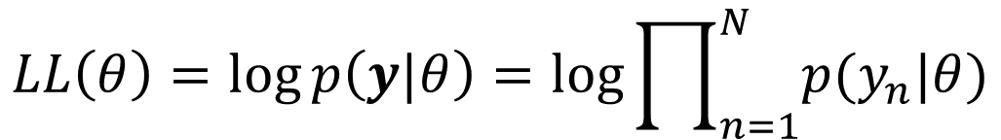
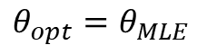
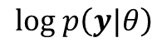
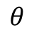
Maximum Likelihood Estimation (MLE)
The goal in MLE is to find the optimal $θ$by maximizing the likelihood
In practice, we maximize the log of the likelihood (log-likelihood in short)
Thus the MLE problem is
$θ_{MLE}= arg\max_{θ} LL\left(θ\right)=arg\max_{θ}\sum_{n=1}^{N}{log p\left(y_{n} | θ\right) }$
This is now an optimization (maximization problem). Note: $θ$may have constraints
Leads to simpler algebra/calculus, and also yields better numerical stability when implementing it om computer (dealing with log of probabilities)
Taking log doesn’t affect the optima since log is a monotonic function
$$log p\left(y|θ\right)$$
$$LL\left(θ\right)=\log{p\left(y|θ\right)}=log\prod_{n=1}^{N}{p(y_{n}|θ)}$$
$$=\sum_{n=1}^{N}{log p\left(y_{n} | θ\right) }$$
$$θ_{opt}=θ_{MLE}$$
$$θ$$

Slide 6
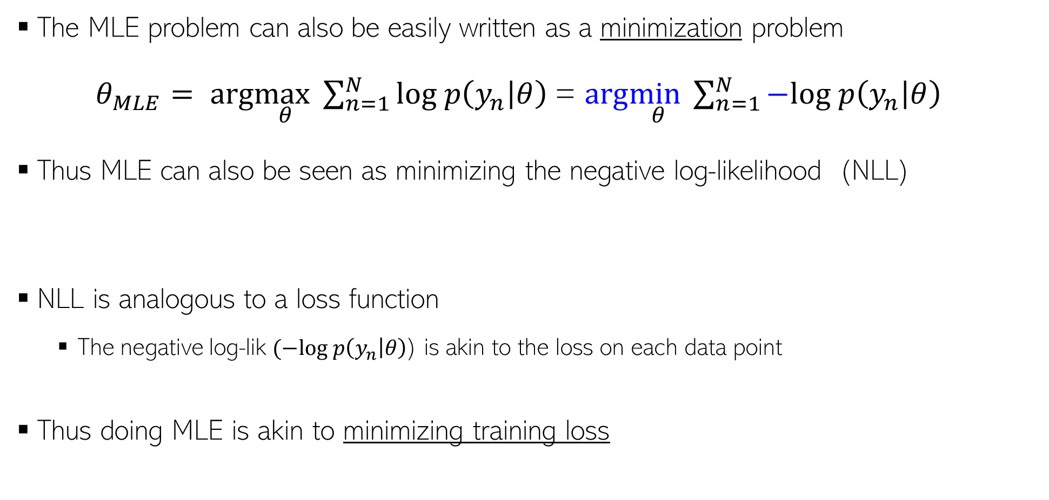
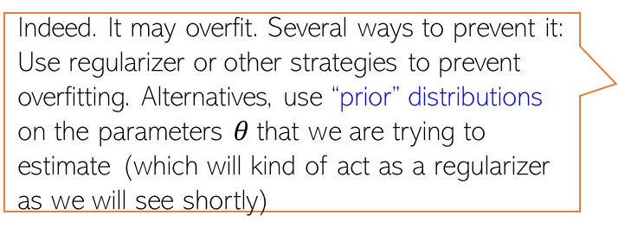
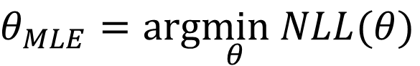
Maximum Likelihood Estimation (MLE)
Negative Log-Likelihood
(NLL)
The MLE problem can also be easily written as a minimization problem
$θ_{MLE}= arg\max_{θ}\sum_{n=1}^{N}{log p\left(y_{n} | θ\right) }$= $arg\min_{θ}\sum_{n=1}^{N}{−log p\left(y_{n} | θ\right) }$
Thus MLE can also be seen as minimizing the negative log-likelihood (NLL)
NLL is analogous to a loss function
The negative log-lik $(−log p\left(y_{n} | θ\right)$) is akin to the loss on each data point
Thus doing MLE is akin to minimizing training loss
Indeed. It may overfit. Several ways to prevent it: Use regularizer or other strategies to prevent overfitting. Alternatives, use “prior” distributions on the parameters $θ$that we are trying to estimate (which will kind of act as a regularizer as we will see shortly)
$θ_{MLE}=arg\min_{θ}$ $NLL(θ)$
Such priors have various other benefits as we will see later
Does it mean MLE could overfit? If so, how to prevent this?

Slide 7
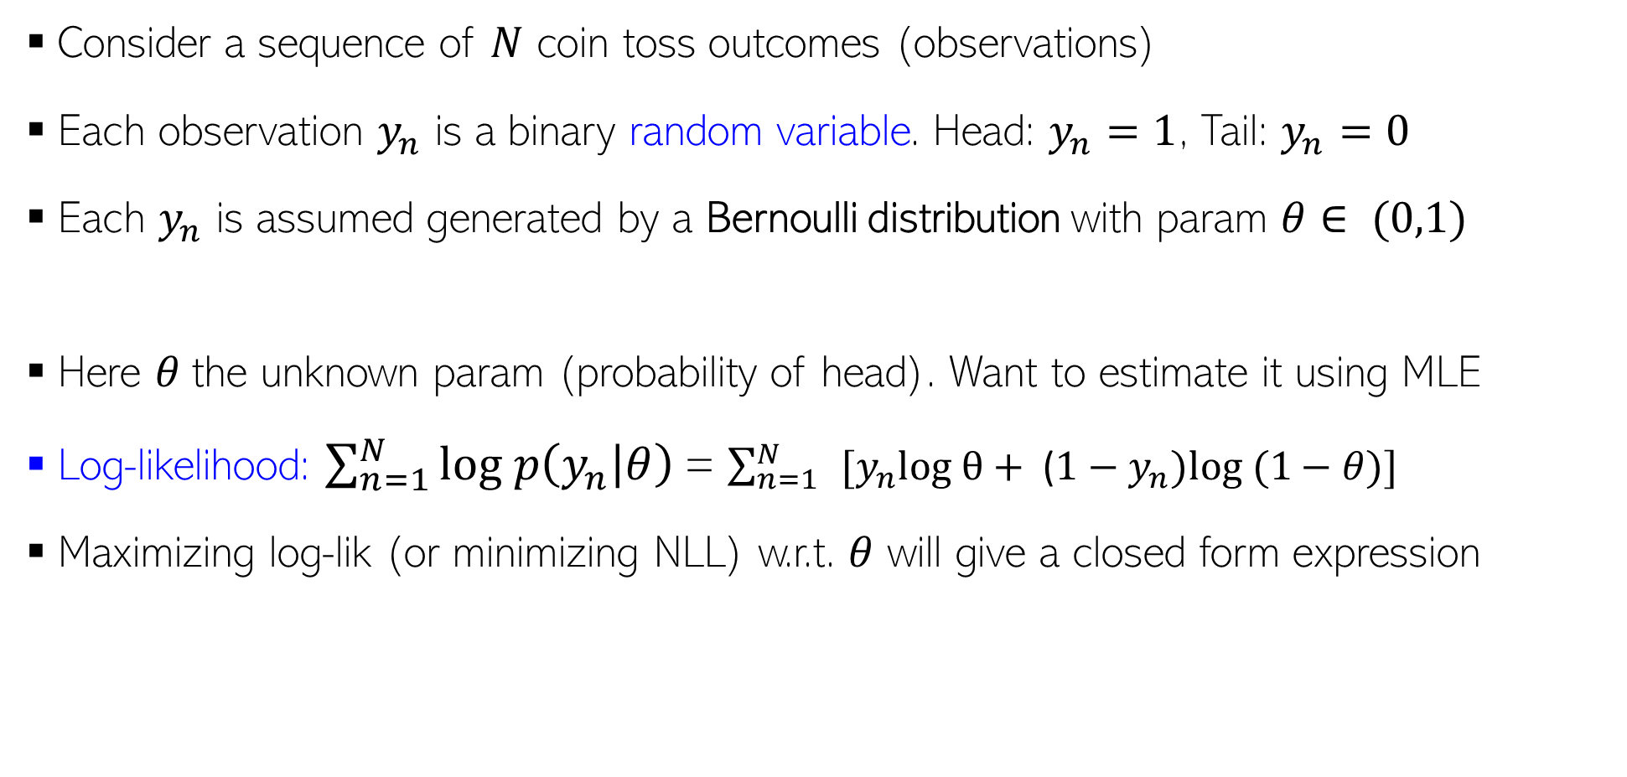
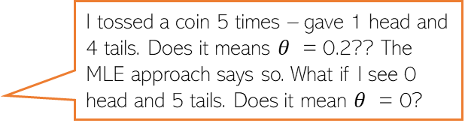
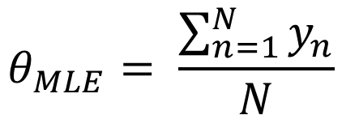
MLE: An Example
Consider a sequence of $N$ coin toss outcomes (observations)
Each observation $y_{n}$ is a binary random variable. Head: $y_{n}=1$, Tail: $y_{n}=0$
Each $y_{n}$ is assumed generated by a Bernoulli distribution with param $θ∈ (0,1)$
Here $θ$the unknown param (probability of head). Want to estimate it using MLE
Log-likelihood: $\sum_{n=1}^{N}{log p\left(y_{n} | θ\right) }$= $\sum_{n=1}^{N}{ }[y_{n}log θ+ \text{(}1−y_{n})log⁡ (1−θ)]$
Maximizing log-lik (or minimizing NLL) w.r.t. $θ$ will give a closed form expression
Probability of a head
$p\left(y_{n} | θ\right)=Bernoulli\left(y_{n} | θ\right)= θ^{y_{n}}$ ${(1−θ)}^{1−y_{n}}$
Take deriv. set it to zero and solve. Easy optimization
I tossed a coin 5 times – gave 1 head and 4 tails. Does it means $θ$ = 0.2?? The MLE approach says so. What if I see 0 head and 5 tails. Does it mean $θ$ = 0?
Thus MLE solution is simply the fraction of heads! ☺ Makes intuitive sense!
Indeed – if you want to trust MLE solution. But with small number of training observations, MLE may overfit and may not be reliable. We will soon see better alternatives that use prior distributions!
$$θ_{MLE}= \frac{\sum_{n=1}^{N}{y_{n}}}{N}$$

Slide 8
Refresher

Slide 9
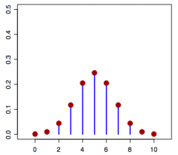
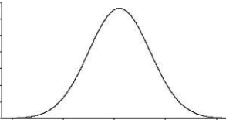
Random Variables
Informally, a random variable (r.v.) $X$ denotes possible outcomes of an event
Can be discrete (i.e., finite many possible outcomes) or continuous
Some examples of discrete r.v.
$X ∈ \{0, 1\}$denoting outcomes of a coin-toss
$X ∈ \{1, 2, . . . , 6\}$denoting outcome of a dice roll
Some examples of continuous r.v.
$X ∈ (0, 1)$denoting the bias of a coin
$X ∈ ℝ$denoting heights of students in CS771
$X ∈ ℝ$denoting time to get to your hall from the department
$$p(X)$$
$X$(a discrete r.v.)
$$p(X)$$
$X$(a continuous r.v.)

Slide 10
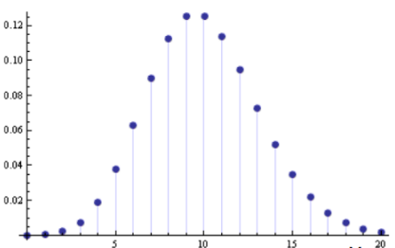
Discrete Random Variables
For a discrete r.v. $X$, $p(x)$ denotes $p(X = x)$ - probability that $X = x$
$p(X)$ is called the probability mass function (PMF) of r.v. $X$
$p(x)$ or $p(X = x)$ is the value of the PMF at $x$
$$p\left(x\right)≥0$$
$$p\left(x\right)≤ 1$$
$$\sum_{x}{p\left(x\right)=1}$$
$$p(X)$$
$$X$$

Slide 11
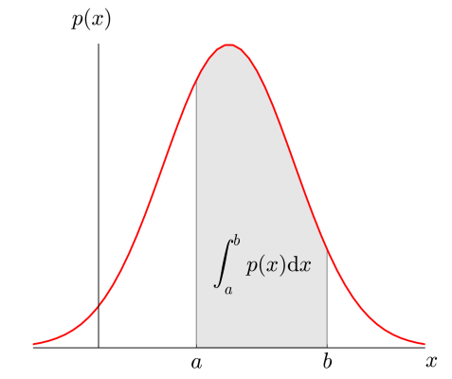
Continuous Random Variables
For a continuous r.v. $X$, a probability $p(X = x)$ or $p(x)$ is meaningless
For cont. r.v., we talk in terms of prob. within an interval $X ∈(x,x+δx)$
$p(x)δx$ is the prob. that $X ∈(x,x+δx)$as $δx→0$
$p(x)$ is the probability density at $X= x$
Yes, probability density at a point $x$ can very well be larger than 1. The integral however must be equal to 1
$$p\left(x\right)≥0$$
$$p\left(x\right)≤ 1$$
$$\int{p\left(x\right)dx=1}$$

Slide 12
A word about notation
$p(.)$can mean different things depending on the context
$p(X)$ denotes the distribution (PMF/PDF) of an r.v. $X$
$p(X = x)$or $p_{X}(x)$ or simply $p(x)$ denotes the prob. or prob. density at value $x$
Actual meaning should be clear from the context (but be careful)
Exercise same care when $p(.)$is a specific distribution (Bernoulli, Gaussian, etc.)
The following means generating a random sample from the distribution $p(X)$
$$x∼p(X)$$

Slide 13
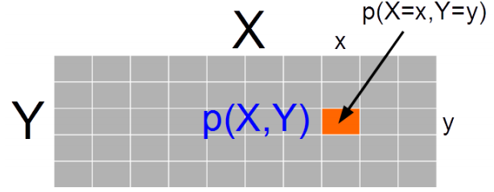
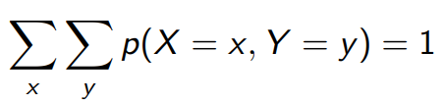
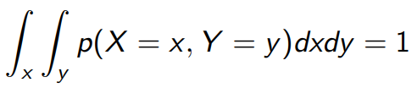
Joint Probability Distribution
Joint prob. dist. $p(X, Y)$ models probability of co-occurrence of two r.v. $X, Y$
For discrete r.v., the joint PMF $p(X, Y )$is like a table (that sums to 1)
For two continuous r.v.’s $X$ and $Y$, we have joint PDF $p(X, Y)$
For 3 r.v.’s, we will likewise have a “cube” for the PMF. For more than 3 r.v.’s too, similar analogy holds
For more than two r.v.’s, we will likewise have a multi-dim integral for this property

Slide 14
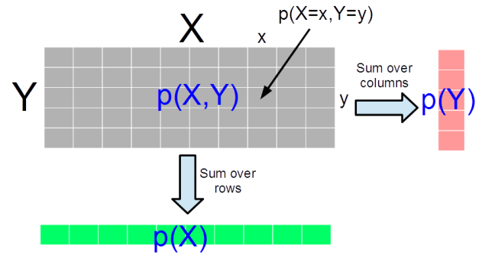
Marginal Probability Distribution
Consider two r.v.’s X and Y (discrete/continuous – both need not of same type)
Marg. Prob. is PMF/PDF of one r.v. accounting for all possibilities of the other r.v.
For discrete r.v.’s, $p\left(X\right)= \sum_{y}{p(X,Y=y)}$ and $p\left(Y\right)=\sum_{x}{p(X=x,Y)}$
For discrete r.v. it is the sum of the PMF table along the rows/columns
For continuous r.v.’s,
The definition also applied for two sets of r.v.’s and marginal of one set of r.v.’s is obtained by summing over all possibilities of the second set of r.v.’s
For discrete r.v.’s, marginalization is called summing over, for continuous r.v.’s, it is called “integrating out”

Slide 15
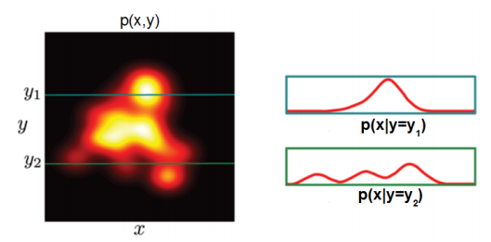
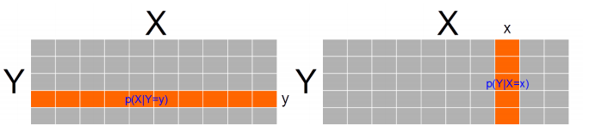
Conditional Probability Distribution
Consider two r.v.’s $X$ and $Y$ (discrete/continuous – both need not of same type)
Conditional PMF/PDF $p(X|Y)$is the prob. dist. of one r.v. $X$, fixing other r.v. $Y$
$p(X|Y = y)$or $p(Y |X = x)$ like taking a slice of the joint dist. $p(X, Y )$
Note: A conditional PMF/PDF may also be conditioned on something that is not the value of an r.v. but some fixed quantity in general
Continuous Random Variables
Discrete Random Variables
We will see cond. dist. of output $y$ given weights $w$(r.v.) and features $X$ written as $p(y|w,X)$

Slide 16
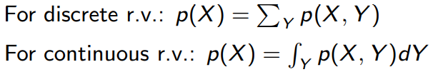
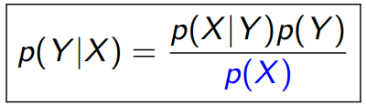
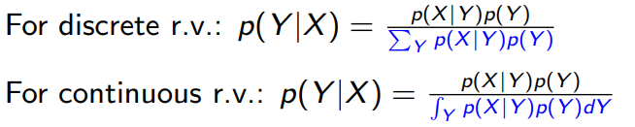
Some Basic Rules
Sum Rule: Gives the marginal probability distribution from joint probability distribution
Product Rule: $p(X, Y) = p(Y |X)p(X) = p(X|Y )p(Y )$
Bayes’ rule: Gives conditional probability distribution (can derive it from product rule)
Chain Rule: $p(X_{1}, X_{2}, . . . , X_{N}) = p(X_{1})p(X_{2}|X_{1}). . . p(X_{N} |X_{1}, . . . , X_{N−1})$

Slide 17
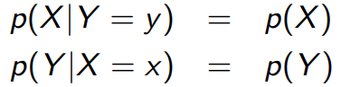
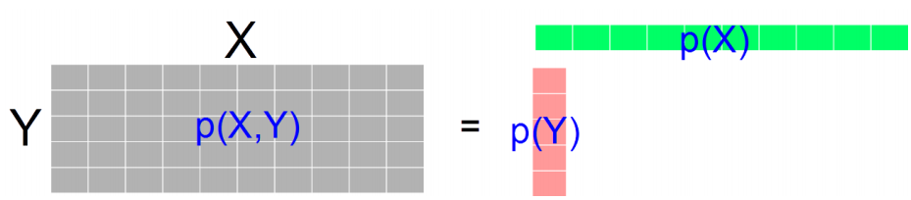
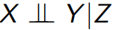
Independence
$X$ and $Y$ are independent when knowing one tells nothing about the other
The above is the marginal independence $(X ⫫ Y)$
Two r.v.’s $X$ and $Y$ may not be marginally indep but may be given the value of another r.v. $Z$

Slide 18
Expectation
Expectation of a random variable tells the expected or average value it takes
Expectation of a discrete random variable $X∈S_{X}$ having PMF $p(X)$
Expectation of a continuous random variable $X$ $∈S_{X}$ having PDF $p(X)$
The definition applies to functions of r.v. too (e.g.., $𝔼\left[f(X)\right]$)
Exp. is always w.r.t. the prob. dist. $p(X)$of the r.v. and often written as $𝔼_{p}\left[X\right]$
$$𝔼[X] = \sum_{x∈S_{X}}{xp(x)}$$
Probability that $X = x$
$$𝔼\left[X\right]=\int{xp\left(x\right)dx}$$
Probability density at $X = x$
Note that this exp. is w.r.t. the distribution $p(f(X))$ of the r.v. $f(X)$
$$x∈S_{X}$$
Often the subscript is omitted but do keep in mind the underlying distribution

Slide 19
Expectation: A Few Rules
$X$ and $Y$ need not be even independent. Can be discrete or continuous
Expectation of sum of two r.v.’s: $𝔼\left[X+Y\right]=𝔼\left[X\right]+𝔼[Y]$
Proof is as follows
Define $Z = X+Y$
$𝔼\left[Z\right]=\sum_{z∈S_{Z}}{z⋅p(Z=z)}$ s.t. $z= x+y$ where $x∈ S_{X}$and $y∈ S_{Y}$
$=\sum_{x∈S_{X}}{\sum_{y∈S_{Y}}{(x+y)⋅p(X=x,Y=y)}}$
$= \sum_{x}{\sum_{y}{x⋅p(X=x,Y=y)}}$ $+ \sum_{x}{\sum_{y}{y⋅p(X=x,Y=y)}}$
$= \sum_{x}{x\sum_{y}{p(X=x,Y=y)}}$ $+ \sum_{y}{y\sum_{x}{p(X=x,Y=y)}}$
$= \sum_{x}{x⋅p(X=x)}$ $+ \sum_{y}{y⋅p(Y=y)}$
$=𝔼\left[X\right]+𝔼[Y]$
Used the rule of marginalization of joint dist. of two r.v.’s

Slide 20
Expectation: A Few Rules (Contd)
$α$is a real-valued scalar
$α$and $β$are real-valued scalars
Expectation of a scaled r.v.: $𝔼\left[αX\right]=α𝔼\left[X\right]$
Linearity of expectation: $𝔼\left[αX+βY\right]=α𝔼\left[X\right]+β𝔼\left[Y\right]$
(More General) Lin. of exp.: $𝔼\left[αf(X)+βg(Y)\right]=α𝔼\left[f(X)\right]+β𝔼\left[g(Y)\right]$
Exp. of product of two independent r.v.’s: $𝔼\left[XY\right]=𝔼\left[X\right]𝔼[Y]$
Law of the Unconscious Statistician (LOTUS): Given an r.v. $X$ with a known prob. dist. $p(X)$ and another random variable $Y = g(X)$for some function $g$
Rule of iterated expectation: $𝔼_{p(X)}\left[X\right]=𝔼_{p(Y)}[𝔼_{p(X|Y)}\left[X|Y\right]$]
$f$ and $g$ are arbitrary functions.
Requires finding $p(Y)$
Requires only $p(X)$ which we already have
$$𝔼\left[Y\right]=𝔼\left[g\left(X\right)\right]=\sum_{y∈S_{Y}}{yp\left(y\right) }$$
$$=\sum_{x∈S_{X}}{g\left(x\right)p(x)}$$
LOTUS also applicable for continuous r.v.’s

Slide 21
Variance and Covariance
Variance of a scalar r.v. tells us about its spread around its mean value $𝔼\left[X\right]= μ$
Standard deviation is simply the square root is variance
For two scalar r.v.’s $X$ and $Y$, the covariance is defined by
For two vector r.v.’s $X$ and $Y$ (assume column vec), the covariance matrix is defined by
Cov. of components of a vector r.v. $X$: $cov\left[X\right]=cov\left[X,X\right]$
Note: The definitions apply to functions of r.v. too (e.g., $var\left[f(X)\right])$
Note: Variance of sum of independent r.v.’s: $var[X + Y] = var[X] + var[Y]$
$$var\left[X\right]=𝔼\left[{\left(X−μ\right)}^{2}\right]=𝔼\left[X^{2}\right] −μ^{2}$$
$$cov\left[X,Y\right]=𝔼\left[\{X−𝔼[X]\}\{Y−𝔼[Y]\}\right]=𝔼\left[XY\right]−𝔼[X]𝔼[Y]$$
$$cov\left[X,Y\right]=𝔼\left[\{X−𝔼[X]\}\{Y^{⊤}−𝔼[Y^{⊤}]\}\right]=𝔼\left[XY^{⊤}\right]−𝔼[X]𝔼[Y^{⊤}]$$
Important result

Slide 22
Transformation of Random Variables
Suppose $Y = f(X) = AX + b$be a linear function of a vector-valued r.v. $X$ ($A$ is a matrix and $b$ is a vector, both constants)
Suppose $𝔼\left[X\right]=μ$ and $cov\left[X\right]=Σ$, then for the vector-valued r.v. $Y$
Likewise, if $Y = f\left(X\right)=a^{⊤}X + b$ be a linear function of a vector-valued r.v. $X$ ($a$ is a vector and $b$ is a scalar, both constants)
Suppose $𝔼\left[X\right]=μ$ and $cov\left[X\right]=Σ$, then for the scalar-valued r.v. $Y$
$$𝔼\left[Y\right]=𝔼\left[AX+b\right]=Aμ+b$$
$$cov\left[Y\right]=cov\left[AX+b\right]=AΣA^{⊤}$$
$$𝔼\left[Y\right]=𝔼\left[a^{⊤}X + b\right]=a^{⊤}μ+b$$
$$var\left[Y\right]=var\left[a^{⊤}X + b\right]=a^{⊤}Σa$$

Slide 23
Common Probability Distributions
Important: We will use these extensively to model data as well as parameters of models
Some common discrete distributions and what they can model
Bernoulli: Binary numbers, e.g., outcome (head/tail, 0/1) of a coin toss
Binomial: Bounded non-negative integers, e.g., # of heads in $n$ coin tosses
Multinomial/multinoulli: One of $K$ (>2) possibilities, e.g., outcome of a dice roll
Poisson: Non-negative integers, e.g., # of words in a document
Some common continuous distributions and what they can model
Uniform: numbers defined over a fixed range
Beta: numbers between 0 and 1, e.g., probability of head for a biased coin
Gamma: Positive unbounded real numbers
Dirichlet: vectors that sum of 1 (fraction of data points in different clusters)
Gaussian: real-valued numbers or real-valued vectors

Slide 24
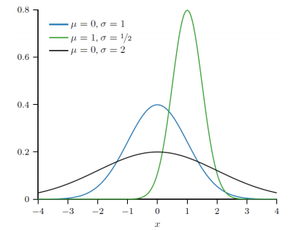
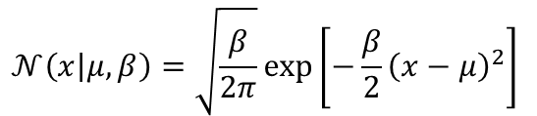
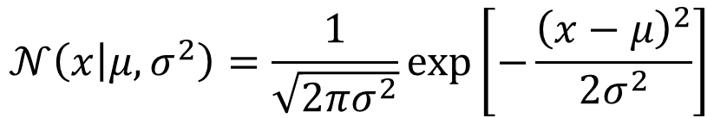
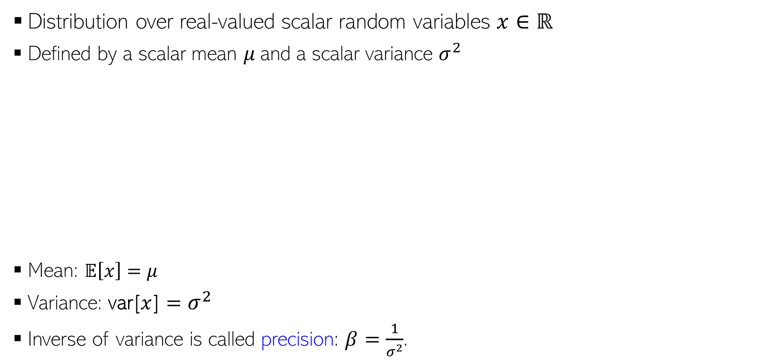
Gaussian Distribution (Univariate)
Distribution over real-valued scalar random variables $x∈ℝ$
Defined by a scalar mean $μ$and a scalar variance $σ^{2}$
Mean: $𝔼\left[x\right]=μ$
Variance: var[$x$] $=σ^{2}$
Inverse of variance is called precision: $β=\frac{1}{σ^{2}}$.
$$𝒩\left(x | μ,σ^{2}\right)=\frac{1}{\sqrt{2πσ^{2}}}exp\left[−\frac{{\left(x−μ\right)}^{2}}{2σ^{2}}\right]$$
Gaussian PDF in terms of precision
$$𝒩\left(x | μ,β\right)=\sqrt{\frac{β}{2π}}exp\left[−\frac{β}{2}{\left(x−μ\right)}^{2}\right]$$

Slide 25
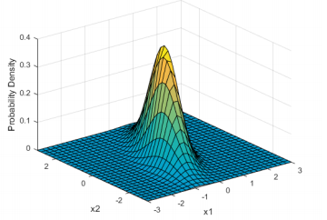
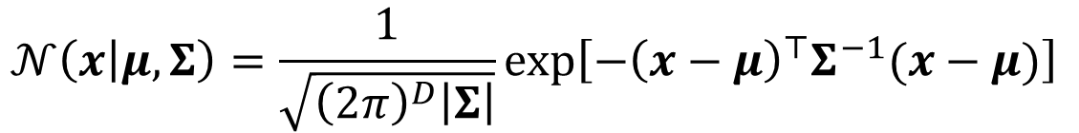

Gaussian Distribution (Multivariate)
Distribution over real-valued vector random variables $x∈ℝ^{D}$
Defined by a mean vector $μ∈ℝ^{D}$and a covariance matrix $Σ$
Note: The cov. matrix $Σ$ must be symmetric and PSD
All eigenvalues are positive
$z^{⊤}Σz≥0$ for any real vector $z$
The covariance matrix also controls the shape of the Gaussian
A two-dimensional Gaussian
$$𝒩\left(x | μ,Σ\right)=\frac{1}{\sqrt{{\left(2π\right)}^{D}\left|Σ\right|}}exp\left[−{\left(x−μ\right)}^{⊤}Σ^{−1}(x−μ)\right]$$

Slide 26






Covariance Matrix for Multivariate Gaussian
Spherical Covariance
Diagonal Covariance
Full Covariance
5
5
5
Spherical: Equal spreads (variances) along all dimensions
Diagonal: Unequal spreads (variances) along all directions but still axis-parallel
-5
5
-5
5
-5
5
5
5
5
Full: Unequal spreads (variances) along all directions and also spreads along oblique directions
-5
5
-5
5
-5
5

Slide 27





Probabilistic Models for Supervised Learning
Goal: Learn the conditional distribution of output given input, i.e., $p(y|x)$
$p(y|x)$ is more informative than a single prediction $y$
From $p(y|x)$, can get “expected” or “most likely” output $y$
For classifn, “soft” predictions (e.g., rather than yes/no, prob. of “yes”)
“Uncertainty” in the predicted output $y$ (e.g., by looking at the variance of $p(y|x)$)
Can also learn a distribution over the model params using fully Bayesian inference
Probabilistic Linear Regression
Probabilistic Classification
$$p(y|x)$$
$$w^{⊤}x (mean)$$
$$y$$
Such uncertainty also helps in “active learning” where we wish to identify “difficult” (and hence more useful) training examples

Slide 28






Probabilistic Models for Supervised Learning
Usually two ways to model the conditional distribution $p(y|x)$
Approach 1: Don’t model $x$, and model $p(y|x)$ directly using a prob. distribution
Approach 2: Model both $x$ and $y$ via their joint distr. and get the conditional as
“discriminative” sup learning
Gaussian distribution
We assume the conditional distribution to be some appropriate distribution and treat the weights $w$ as learnable parameters of the model (using MLE/MAP/fully Bayesian inference). Need not be a linear model – can replace $w^{⊤}x$ by a nonlinear function $f(x)$
$$p\left(y | x,w\right)=𝒩(y|w^{⊤}x,β^{−1})$$
Probabilistic linear regression
The “sigmoid” function
$$p\left(y | x,w\right)=Bernoulli(y|{σ(w}^{⊤}x))$$
Probabilistic linear binary classification
Here $θ$denotes all the model parameters that we need to model the joint distribution of $x$ and $y$ (will see examples later)
“generative” sup learning
$$p\left(y | x,θ\right)=\frac{p(x,y|θ)}{p(x|θ)}$$
Prob. distribution of inputs from class $k$
Called “generative” because we are learning the generative distributions for output as well as inputs
$p\left(y=k | x,θ\right)=\frac{p(x,y=k|θ)}{p(x|θ)}$ $=\frac{p\left(x | y=k,θ\right)p(y=k|θ)}{\sum_{ℓ=1}^{K}{p\left(x | y=ℓ,θ\right)p(y=ℓ|θ)}}$
For a multi-class classification model with $K$ classes

Slide 29
Probabilistic Linear Regression
$$p\left(y | x,w\right)=𝒩(y|w^{⊤}x,β^{−1})$$
Gaussian distribution
Other distributions can also be used for probabilistic linear regression (e.g., Laplace) as we will see later

Slide 30







Linear Regression: A Probabilistic View
Defines our likelihood model: $p(y_{n}|w,x_{n})$ - Gaussian
Output $y_{n}$ generated from a linear model and then zero mean Gaussian noise added
Output $y_{n}$ assumed generated from a Gaussian with mean $w^{⊤}x_{n}$
Mean
Variance
Equivalently:
$$y_{n}= w^{⊤}x_{n}+ε_{n}$$
Note the term in the Gaussian’s exponent – just like a squared error we saw for least squares regression ☺
$ε_{n}∼𝒩(0,$ $β^{−1})$
Using a Laplace distribution would correspond to using an absolute loss
Gaussian
Several variants of this basic model are possible
Other distributions to model the additive noise (e.g., Laplace)
Different noise variance/precision for each output: $y_{n}∼𝒩(w^{⊤}x_{n},$ $β_{n}^{−1})$
Heteroskedastic noise

Slide 31








MLE for Probabilistic Linear Regression
Since each likelihood term is a Gaussian, we have
Thus the overall likelihood (assuming i.i.d. responses) will be
Log-likelihood (ignoring constants w.r.t. $w$)
Negative log likelihood (NLL) in this case is similar to squared loss function
Also note that $x_{n}$ is fixed here but the likelihood depend on it, so it is being conditioned on
$$p\left(y_{n} | w,x_{n}\right)=𝒩\left(y_{n} | w^{⊤}x_{n},β^{−1}\right)=\sqrt{\frac{β}{2π}}exp\left[−\frac{β}{2}{\left(y_{n}−w^{⊤}x_{n}\right)}^{2}\right]$$
Omitting $β$from the conditioning side for brevity
Exercise: Verify that you can also write the overall likelihood as a single $N$ dimensional Gaussian with mean $Xw$ and cov. matrix $β^{−1}I_{N}$
MLE for probabilistic linear regression with Gaussian noise is equivalent to least squares regression without any regularization (with solution ${\hat{w}}_{MLE}= {(X^{⊤}X)}^{−1}$ $X^{⊤}y$

Slide 32
Classification Motivation
A person arrives at the emergency room with a set of symptoms that could possibly be attributed to one of three medical conditions.
{Stroke, Drug Overdose, Epileptic Seizure}
Which of the three conditions does the individual have?
An online banking service must be able to determine whether or not a transaction being performed on the site is fraudulent, on the basis of the user’s IP address, past transaction history, and so forth.
On the basis of DNA sequence data for a number of patients with and without a given disease, a biologist would like to figure out which DNA mutations are deleterious (disease-causing) and which are not.

Slide 33
Why not linear regression for Classification
No ordering possible
Say, we encode: Stroke=1, Drug Overdose=2, Epileptic Seizure =3
Is “drug overdose” midway between “Stroke” and Seizure?
Linear Regression predictions can be –ve and also outside the desired range for some values of input. How can we control that?

Slide 34

Logistic Regression
Let’s take a dataset: Loan default
We wish to compute
$$P\left[Default=Yes\right|Balance=X]$$
We may model,
$$p\left(X\right)=β_{0}+β_{1}X$$
What is the problem with this approach?

Slide 35

Logistic Function/Odds/LogOdds/Logit
$p\left(X\right)=\frac{e^{β_{0}+β_{1}X}}{{1+ e}^{β_{0}+β_{1}X}}$ [Logistic Function]
Odds = $\frac{p\left(x\right)}{1− p\left(x\right)}=e^{β_{0}+β_{1}X}$
$\log\left(\frac{p\left(x\right)}{1− p\left(x\right)}\right)=β_{0}+β_{1}X$ [Log-odds/Logit]

Slide 36






Logistic Regression (LR)
Both very widely used
Multi-class extension known as “softmax regression”
The word “regression” is a misnomer. Both are classification models
A probabilistic model for binary classification
Learns the PMF of the output label given the input, i.e., $p(y|x)$
A discriminative model: Does not model inputs $x$ (only relationship b/w $x$ and $y$)
Uses the sigmoid function to define the conditional probability of $y$ being 1
Here $w^{⊤}x$ is the score for input $x$. The sigmoid turns it into a probability
$$μ_{x}=p\left(y=1 | w,x\right)=σ(w^{⊤}x)$$
$σ$(z)
1
$$= \frac{1}{1+exp(−w^{⊤}x)}$$
0.5
$$= \frac{exp(w^{⊤}x)}{1+exp(w^{⊤}x)}$$
A linear model
0
$$\text{z}$$

Slide 37



LR: Decision Boundary
At the decision boundary where both classes are equiprobable
Very large positive $w^{⊤}x$ means $p\left(y=1 | w,x\right)$ close to 1
Very large negative $w^{⊤}x$ means $p\left(y=0 | w,x\right)$ close to 1
At decision boundary, $w^{⊤}x$ = 0 implies $p\left(y=1 | w,x\right)$ = $p\left(y=0 | w,x\right)$ = 0.5
A linear hyperplane

Slide 38





MLE for Logistic Regression
Assumed 0/1, not -1/+1
Likelihood (PMF of each input’s label) is Bernoulli with prob $μ_{n}=\frac{exp(w^{⊤}x_{n})}{1+exp(w^{⊤}x_{n})}$
Overall likelihood, assuming i.i.d. observations
The negative log-likelihood $NLL\left(w\right)=−log p\left(y | w,X\right)$ simplifies to
Plugging in $μ_{n}=\frac{exp(w^{⊤}x_{n})}{1+exp(w^{⊤}x_{n})}$ and simplifying
$$p\left(y_{n} | w,x_{n}\right)=Bernoulli\left(μ_{n}\right)=μ_{n}^{y_{n}}{(1−μ_{n})}^{1−y_{n}}$$
$$p\left(y | w,X\right)=\prod_{n=1}^{N}{p\left(y_{n} | w,x_{n}\right)=\prod_{n=1}^{N}{μ_{n}^{y_{n}}{(1−μ_{n})}^{1−y_{n}}}}$$
“cross-entropy” loss (a popular loss function for classification)
Loss function
$$NLL\left(w\right)=\sum_{n=1}^{N}{−\left[y_{n}log μ_{n}+\left(1−y_{n}\right)log (1−μ_{n})\right]}$$
Very large loss if $y_{n}$ close to 1and $μ_{n}$ close to 0, or vice-versa
Good news: For LR, NLL is convex
No closed-form expression for ${\hat{w}}_{MLE}=arg \min_{w} NLL(w)$
Iterative opt needed (gradient or Hessian based). Exercise: Try working out the gradient of NLL and notice the expression’s form
$$NLL\left(w\right)=−\sum_{n=1}^{N}{\left[y_{n}w^{⊤}x_{n}−log (1+exp(w^{⊤}x_{n}))\right]}$$

Slide 39


An Alternate Notation
If we assume the label $y_{n}$ as -1/+1 (not 0/1), the likelihood can be written as
Slightly more convenient notation: A single expression gives the probabilities of both possible label values
In this case, the total negative log-likelihood will be
$$p\left(y_{n} | w,x_{n}\right)=\frac{1}{1+exp(−y_{n}w^{⊤}x_{n})}=σ(y_{n}w^{⊤}x_{n})$$
$NLL\left(w\right)= \sum_{n=1}^{N}{−log p\left(y_{n} | w,x_{n}\right)=}$ $\sum_{n=1}^{N}{log (1+exp\left(−y_{n}w^{⊤}x_{n}\right))}$

Slide 40
Predicting Defaulters!!
Prediction for Credit Card Stmt. balance = $1000 is 0.576 %
Prediction for Credit Card Stmt. balance = $2000 is 58.6%

Slide 41
Predicting Defaulters!!
Students tend to default more than non-students!

Slide 42

Multiple Logistic Regression
$\log\left(\frac{p\left(x\right)}{1− p\left(x\right)}\right)=β_{0}+β_{1}X_{1}+…+β_{p}X_{p}$
Model with p predictors

Slide 43
Predicting Defaulters!!
Income: Is it significant predictor of defaulters?
Coefficient for “Student=Yes” is –ve? How is it possible?

Slide 44
Solving the mystery (Confounding variable)
The student default rate is at or below that of the non-student default rate for every value of balance.
Default rates for students and non-students averaged over all values of balance and income, suggest the opposite effect: the overall student default rate is higher than the non-student default rate
The variables student and balance are correlated. Students tend to hold higher levels of debt, which is associated with higher probability of default.
A student is riskier than a non-student if no information about the student’s credit card balance is available. However, that student is less risky than a non-student with the same credit card balance!

Slide 45





Multiclass Logistic (a.k.a. Softmax) Regression
Also called multinoulli/multinomial regression: Basically, LR for $K > 2$classes
In this case, $y_{n}∈\left\{1,2,…,K\right\}$ and label probabilities are defined as
$K$ weight vecs $w_{1},w_{2},…,w_{K}$(one per class), each $D$-dim, and $W=[w_{1},w_{2},…,w_{K}]$
Each likelihood $p\left(y_{n} | x_{n},W\right)$is a multinoulli distribution. Therefore total likelihood
Can do MLE/MAP/fully Bayesian estimation for $W$ similar to LR model
Softmax function
$$p\left(y_{n}=k | x_{n},W\right)= \frac{exp(w_{k}^{⊤}x_{n})}{\sum_{ℓ=1}^{K}{exp(w_{ℓ}^{⊤}x_{n})}}=μ_{nk}$$
Also note that $\sum_{ℓ=1}^{K}{μ_{nℓ}}$ =1 for any input $x_{n}$
$$p\left(y|X,W\right)= \prod_{n=1}^{N}{\prod_{ℓ=1}^{K}{μ_{nℓ}^{y_{nℓ}}}}$$
Notation: $y_{nℓ}$ = 1 if true class of $x_{n}$ is $ℓ$ and $y_{nℓ^{′}}$ = 0 $∀ ℓ^{′}$ $≠ℓ$

Slide 46

Multinomial Logistic Regression
Softmax coding: K classes
$P\left[Y=k | X=x\right]=\frac{e^{w_{k0}+w_{k1}x_{1}+…+w_{kp}x_{p}}}{Σ_{l=1}^{K}e^{w_{l0}+w_{l1}x_{1}+…+w_{lp}x_{p}}}$
We estimate the coefficients for all K classes.
Log Odds:
$\log\left(\frac{P\left[Y=k | X=x\right]}{P\left[Y=k^{′} | X=x\right]}\right)={(w}_{k0}−w_{k^{′}0})+{(w}_{k1}{−w}_{k^{′}1})x_{1}+…+(w_{kp}−{w_{k′p}^{})x}_{p}$

Slide 47
Generative Models for Classification
Model the distribution of the predictors X separately in each of the response classes (for each value of Y )
Alternative to modeling p(Y|X)
We then use Bayes’ theorem to flip these around into estimates for Pr(Y = k|X = x)
When the distribution of X within each class is assumed to be normal, it turns out that the model is very similar in form to logistic regression.
Why?
Logistic Regression is unstable when there is substantial separation between the two classes
Generative methods considered here do not suffer from this problem.
If the distribution of the predictors X is approximately normal in each of the classes and the sample size is small, then the approaches in this section may be more accurate than logistic regression.
Can be naturally extended to the case of more than two response classes.

Slide 48










Generative Classification: A Basic Idea
Learn the probability distribution of inputs from each class (“class-conditional”)
Usually assume some form (e.g., Gaussian) and estimate the parameters of that distribution (using MLE/MAP/fully Bayesian approach)
Predict label of a test input $x_{∗}$by comparing its probabilities under each class
Or can report the probability of belonging to each class (soft prediction)
Yes. We can do it by incorporating class prior probabilities (proportion of each class in the training data) in our model
What if I a priori expect that the red class is more likely for a test input because the training data also had more red examples?
$$p(x|"red")$$
Then we can compute and compare the class posterior probabilities of each class for the test input
$$p(x_{∗}|class)$$
$$p(x_{∗}|class)$$
$$p(x|"green")$$
Can I incorporate that knowledge?
$$p(x_{∗}|class)$$
Going to talk about this next
$$x_{∗}$$
$$x_{∗}$$
$$x_{∗}$$

Slide 49








Generative Classification: More Generally..
Roughly speaking, what’s the fraction of each class in the training data
Consider a classification problem with $K ≥ 2$classes
The class prior probability of each class $k∈ \{1,2,…,K\}$ is $p(y=k)$
Can use Bayes rule to compute class posterior probability for a test input $x_{∗}$
We will first estimate the parameters of class prior and class-conditional distributions. Once estimated, we can use the above rule to predict the label for any test input
Can use MLE/MAP/fully Bayesian approach. We will only consider MLE/MAP here
Class prior distribution for class $k$
Class-conditional distribution of inputs from class $k$
$$p\left(y_{∗}=k | x_{∗},θ\right)= \frac{p\left(x_{∗},y_{∗}=k | θ\right)}{p(x_{∗}|θ)}$$
$$=\frac{p\left(y_{∗}=k | θ\right)p(x_{∗}|y_{∗}=k,θ)}{p(x_{∗}|θ)}$$
$θ$ collectively denotes the parameters the joint distribution of inputs and labels depends on
Setting $p\left(y_{∗}=k | θ\right)=1/K$ will give us the approach that predicts by comparing the probabilities $p(x_{∗}|y_{∗}=k,θ)$ of $x_{∗}$under each of the classes
This is just the marginal distribution of the joint distribution in the numerator (summed over all $K$ values of $y_{∗}$)

Slide 50







Estimating Class Priors
Note: Can also do MAP estimation using a Dirichlet prior on $π$ (this is akin to using Beta prior for doing MAP estimation for the bias of a coin). May try this as an exercise
Estimating class priors $p(y=k)$ is usually straightforward in gen. classification
Roughly speaking, it is the proportion of training examples from each class
Note: The above is true only when doing MLE (as we will see shortly)
If estimating class priors using MAP/fully Bayesian, they will be a “smooth version” of the proportions (because of the effect of regularization)
The class prior distribution is assumed to be a discrete distribution (multinoulli)
Given N i.i.d. labelled examples ${\{\left(x_{n},y_{n}\right)\}}_{n=1}^{N}$, $y_{n}∈ \{1,2,…,K\}$ the MLE soln
$$π_{k} = p(y=k)$$
These probabilities sum to 1: $\sum_{k=1}^{K}{π_{k}=1}$
Generalization of Bernoulli
$p\left(y | π\right)=multinoulli(y|π_{1},π_{2},…,π_{K})= \prod_{k=1}^{K}{π_{k}^{𝕀[y=k]}}$
$$π_{MLE}=arg\max_{π} \sum_{n=1}^{N}{log p\left(y_{n}\right|π)}$$
Exercise: Verify that the MLE solution will be ${p\left(y=k\right)= π}_{k}=N_{k}/N$
where $N_{k}= \sum_{n=1}^{N}{𝕀[y=k]}$
(the frac. of class $k$ examples)
Can use Lagrange based opt. (note that we have an equality constraint)
Subject to constraint $\sum_{k=1}^{K}{π_{k}=1}$

Slide 51



Estimating Class-Conditionals
To be estimated using inputs from class $k$
Can assume an appropriate distribution $p(x|y=k,θ)$for inputs of each class
If $x$ is $D$-dim, it will be a $D$-dim. distribution. Choice depends on various factors
Nature of input features, e.g.,
If $x∈ℝ^{D}$, can use a $D$-dim Gaussian $𝒩\left(x | μ_{k}{,Σ}_{k}\right)$
If $x∈{\{0,1\}}^{D}$, can use $D$ Bernoullis (one for each feature)
Can also choose more flexible/complex distributions if possible to estimate
Amount of training data available
With little data from a class, difficult to estimate the params of its class-cond. distribution
Once decided the form of class-cond, estimate $θ$via MLE/MAP/Bayesian infer.
This essentially is a density estimation problem for the class-cond.
In principle, can use any density estimation method
Some workarounds: Use strong regularization, or a simple form of the class-conditional (e.g., use a spherical/diagonal rather than a full covariance if the class-cond is Gaussian), or assume features are independent given class (“naïve Bayes” assumption)
A big issue especially if the number of features ($D$) is very large

Slide 52





Gen. Classifn. using Gaussian Class-conditionals
A benefit of modeling each class by a distribution (recall that LwP had issues)
The generative classification model $p\left(y=k | x\right)= \frac{p(y=k)p(x|y=k)}{p(x|θ)}$
Assume each class-conditional $p(x|y=k)$to be a Gaussian
Class prior is multinoulli (we already saw): $p\left(y=k\right)=π_{k}, π_{k}∈\left(0,1\right), \sum_{k=1}^{K}{π_{k}}=1$
Let’s denote the parameters of the model collectively by $θ={\{π_{k},μ_{k},Σ_{k}\} }_{k=1}^{K}$
Can estimate these using MLE/MAP/Bayesian inference
Already saw the MLE solution for $π:π_{k}=N_{k}/N$ (can also do MAP)
MLE solution for $μ_{k}= \frac{1}{N_{k}}$ $\sum_{y_{n}=k}{x_{n}}$, $Σ_{k}= \frac{1}{N_{k}}$ $\sum_{y_{n}=k}{{{(x}_{n}−μ_{k}){(x}_{n}−μ_{k})}^{⊤}}$
If using point est (MLE/MAP) for $θ$, predictive distribution will be
Since the Gaussian’s covariance models its shape, we can learn the shape of each class ☺
$$𝒩\left(x | μ_{k},Σ_{k}\right)=\frac{1}{\sqrt{{\left(2π\right)}^{D}\left|Σ_{k}\right|}}exp\left[−{\left(x−μ_{k}\right)}^{⊤}Σ^{−1}(x−μ_{k})\right]$$
Can also do MAP estimation for $μ_{k},Σ_{k}$ using a Gaussian prior on $μ_{k}$ and inverse Wishart prior on $Σ_{k}$
Exercise: Try to derive this. I will provide a separate note containing the derivation
Can predict the most likely class for the test input $x_{∗}$by comparing these probabilities for all values of $k$
Note that the exponent has a Mahalanobis distance like term. Also, accounts for the fraction of training examples in class k

Slide 53



Decision Boundary with Gaussian Class-Conditional
As we saw, the prediction rule when using Gaussian class-conditional
The decision boundary between any pair of classes will be a quadratic curve
Reason: For any two classes $k$ and $k^{′}$ at the decision boundary, we will have $p\left(y=k | x,θ\right)=p(y=k^{′}|x,θ)$. Comparing their logs and ignoring terms that don’t contain $x$, can easily see that
Decision boundary contains all inputs $x$ that satisfy the above
This is a quadratic function of $x$ (this model is sometimes referred to Quadratic Discriminant Analysis)

Slide 54




Decision Boundary with Gaussian Class-Conditional
Assume all classes are modeled using the same covariance matrix $Σ_{k}=Σ, ∀k$
In this case, the decision boundary b/w any pair of classes will be linear
Reason: Again using $p\left(y=k | x,θ\right)=p(y=k^{′}|x,θ)$, comparing their logs and ignoring terms that don’t contain $x$, we have
Quadratic terms of $x$ will cancel out; only linear terms will remain; hence decision boundary will be a linear function of $x$ (Exercise: Verify that we can indeed write the decision boundary between this pair of classes as $w^{⊤}x+b=0$ where $w$ and $b$ depend on $μ_{k}$, $μ_{k^{′}}$ and $Σ$)
If we assume the covariance matrices of the assumed Gaussian class-conditionals for any pair of classes to be equal, then the learned separation boundary b/w this pair of classes will be linear; otherwise, quadratic as shown in the figure on left

Slide 55





A Closer Look at the Linear Case
For the linear case (when $Σ_{k}=Σ, ∀k$), the class posterior probability
Expanding further, we can write the above as
Therefore, the above class posterior probability can be written as
The above has exactly the same form as softmax classification(thus softmax is a special case of a generative classification model with Gaussian class-conditionals)
If all Gaussians class-cond have the same covariance matrix (basically, of all classes are assumed to have the same shape)

Slide 56




A Very Special Case: LwP Revisited
Note the prediction rule when $Σ_{k}=Σ, ∀k$
Also assume all classes to have equal no. of training examples, i.e., $π_{k}=1/K$. Then
Equivalent to assigning $x$ to the “closest” class in terms of a Mahalanobis distance
If we further assume $Σ=I_{D}$ then the above is exactly the LwP rule
The Mahalanobis distance matrix = $Σ^{−1}$

Slide 57


Generative Classification: Some Comments
A simple but powerful approach to probabilistic classification
Especially easy to learn if class-conditionals are simple
E.g., Gaussian with diagonal covariances ⇒ Gaussian naïve Bayes
Another popular model is multinomial naïve Bayes (widely used for document classification)
The naïve Bayes assumption: features are conditional independent given class label
Can choose the form of class-conditionals $p(x|y=k)$ based on the type of inputs $x$
Can handle missing data (e.g., if some part of the input $x$ is missing) or missing labels
Generative models are also useful for unsup. and semi-sup. learning
Benefit: Instead of estimating a $D$-dim distribution which may be hard (if we don’t have enough data), we will estimate $D$ one-dim distributions (much simpler task)
$p\left(x | y=k\right)=$ $\prod_{d=1}^{D}{p(x_{d}|y=k)}$
Will see such methods later
Will see such methods later

Slide 58


Generative Models for Regression
Yes, we can even model regression problems using a generative approach
Note that the output y is not longer discrete (so no notion of a class-conditional)
However, the basic rule of recovering a conditional from joint would still apply
Thus we can model the joint distribution $p\left(x,y | θ\right)$of features $x$ and outputs $y∈ℝ$
If features are real-valued the we can model $p\left(x,y | θ\right)$using a $(D+1)$-dim Gaussian
From this $(D+1)$-dim Gaussian$,$we can get $p\left(y | x,θ\right)$using Gaussian conditioning formula
If joint is Gaussian, any subset of variables ($y$ here), given the rest ($x$ here) is also a Gaussian!
Refer to the Gaussian results from maths refresher slides for the result
$$p\left(y | x,θ\right)= \frac{p\left(x,y | θ\right)}{p(x|θ)}$$

Slide 59


Discriminative vs Generative
Proponents of discriminative models: Why bother modeling $x$ if $y$ is what you care about? Just model $y$ directly instead of working hard to model x by learning the class-conditional
Recall that discriminative approaches model $p(y|x)$ directly
Generative approaches model $p(y|x)$ via $p(x,y)$
Number of parameters: Discriminative models have fewer parameters to be learned
Just the weight vector/matrix $w/W$ in case of logistic/softmax classification
Ease of parameter estimation: Debatable as to which one is easier
For “simple” class-conditionals, easier for gen. classifn model (often closed-form solution)
Parameter estimation for discriminative models (logistic/softmax) usually requires iterative methods(although objective functions usually have global optima)
Dealing with missing features: Generative models can handle this easily
E.g., by integrating out the missing features while estimating the parameters)
Inputs with features having mixed types: Generative model can handle this
Appropriate $p(x_{d}|y)$ for each type of feature in the input. Difficult for discriminative models

Slide 60
Discriminative vs Generative (Contd)
Leveraging unlabeled data: Generative models can handle this easily by treating the missing labels are latent variables and are ideal for Semi-supervised Learning. Discriminative models can’t do it easily
Adding data from new classes: Discriminative model will need to be re-trained on all classes all over again. Generative model will just require estimating the class-cond of newly added classes
Have lots of labeled training data? Discriminative models usually work very well
Final Verdict? Despite generative classification having some clear advantages, both methods can be quite powerful (the actual choice may be dictated by the problem)
Important to be aware of their strengths/weaknesses, and also the connections between these
Possibility of a Hybrid Design? Yes, Generative and Disc. models can be combined, e.g.,
“Principled Hybrids of Generative and Discriminative Models” (Lassere et al, 2006)
“Deep Hybrid Models: Bridging Discriminative & Generative Approaches” (Kuleshov & Ermon, 2017)

Slide 61
Generalized Linear Models
We may sometimes be faced with situations in which Y is neither qualitative nor quantitative, and so neither linear regression or classification approaches covered so far are applicable.
Example of Bikeshare dataset
Response: bikers, the number of hourly users of a bike sharing program in Washington, DC. This response value is neither qualitative nor quantitative: instead, it takes on non-negative integer values, or counts
Covariates:
mnth (month of the year),
hr (hour of the day, from 0 to 23),
workingday (an indicator variable that equals 1 if it is neither a weekend nor a holiday),
temp (the normalized temperature,in Celsius), and
weathersit : {clear; misty or cloudy; light rain or light snow; or heavy rain or heavy snow}

Slide 62
Linear regression model
Month
Hr
Weathersit
Are considered qualitative variables

Slide 63
What could be the problems with this?
9.6% of the fitted values in the Bikeshare data set are negative: that is, the linear regression model predicts a negative number of users during 9.6% of the hours in the data set.
Can we perform meaningful predictions on the data?
Concerns about the accuracy of the coefficient estimates, confidence intervals, and other outputs of the regression model
The number of bikers is +ve, integer valued
Heteroskedastic: As the mean number of bikers increase, so does the variance

Slide 64

Possible solution
Log transformation of the response, Y
$$\log\left(Y\right)=Σ_{j=1}^{p}X_{j}w_{j}+ε$$
Avoids the possibility of negative predictions,
Overcomes much of the heteroscedasticity in the untransformed data

Slide 65

Poisson Regression
Poisson Distribution: $P\left[Y=k\right]=\frac{e^{−λ}λ^{k}}{k!}$for k = 0,1,2…
$λ$>0, is the expected value of Y = Var[Y]
We expect the mean number of users of the bike sharing program, λ = E(Y ), to vary as a function of the hour of the day, the month of the year, the weather conditions, and so forth.
So rather than modeling the number of bikers, Y , as a Poisson distribution with a fixed mean value like λ = 5, we would like to allow the mean to vary as a function of the covariates.
$\log\left(λ\right)=w_{0}+w_{1}x_{1}+…+w_{p}x_{p}$

Slide 66

Results of Poisson Regression
Parameters are estimated using MLE approach
$l\left(w_{0}, w_{1}, …, w_{p}\right)=Π_{i=1}^{n}\frac{e^{−λ(x_{i})}λ{\left(x_{i}\right)}^{y_{i}}}{y_{i}!}$
Where $\log\left(λ(x_{i})\right)=w_{0}+w_{1}x_{1}+…+w_{p}x_{p}$

Slide 67
Notable Points

Slide 68
Generalization

Slide 69











Distribution over model parameters??
Recall that linear/ridge regression gave a single “optimal” weight vector
With a probabilistic model for linear regression, we have two options
Use MLE/MAP to get a single “optimal” weight vector
Use fully Bayesian inference to learn a distribution over weight vectors (figure below)
Rather than returning just a single “best” solution (a line in this example), the fully Bayesian approach would give us several “probable” lines (consistent with training data) by learning the full posterior distribution over the model parameters (each of which corresponds to a line)
One training ex
Two training ex
A few more training ex
$$p\left(y_{∗}\right|X,y)=$$
$$p\left(y_{∗} | w,x\right)$$
$$p\left(w | X,y\right)$$
$$dw$$
In this course, we will mostly focus on probabilistic ML when using MLE/MAP and predictive distributions computed using a single best estimate (MLE/MAP). We will only briefly look some simple examples with fully Bayesian approach (CS772/775 covers this approach in greater depth)
Posterior predictive distribution by doing posterior weighted averaging over all possible $w$, not just the most likely one. Thus more robust predictions especially if we are uncertain about the best solution.
How important/like this $w$ is under the posterior distribution(its posterior probability)
Predictive distribution using a single $w$ (plug-in predictive distribution)

